Slide 1

E-Commerce Website
Task - 2

Slide 2
E-Commerce Website
An e-commerce website or app is one of the best full-stack development projects you can practice at the advanced level. It is a vast project involving front and back-end technologies and database knowledge for efficient execution and implementation. The project takes time and effort because you must maintain a huge database with multiple product categories and prices.

Slide 3
Task - 2
Create various Front End Programs
Draw and design a uniform front end code for calculator
Draw and design a interactive front end code for text-editor
Evaluation Metric:
100% Completion of the above tasks
Learning Outcome
Get to know about concepts of project bucketing
Knowing about various frontend development framework like angular, vue,react
Know about various react topics like components, props, state, life cycle etc.

Slide 4
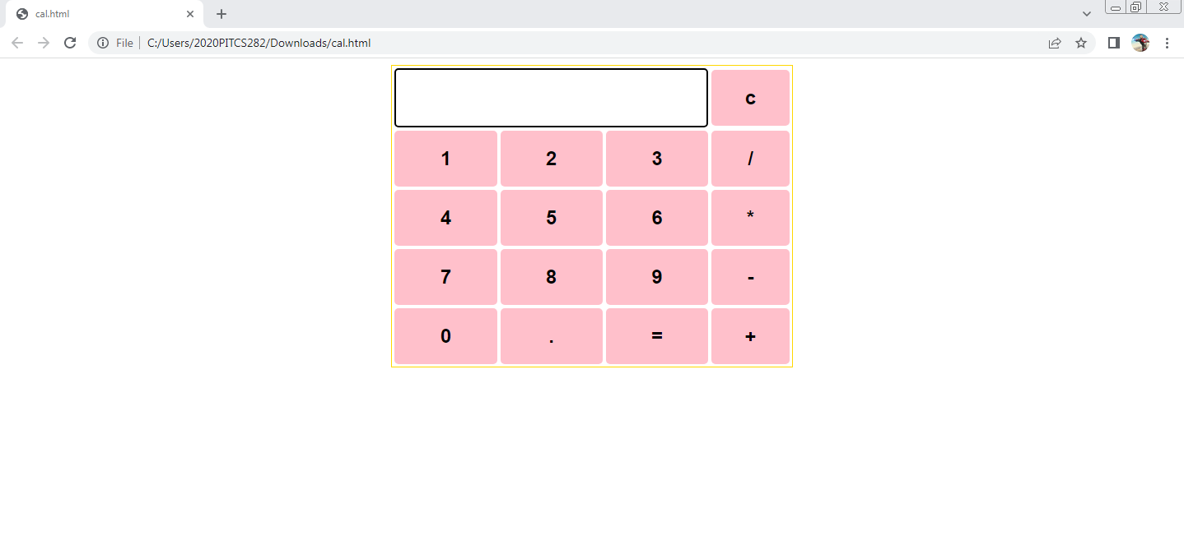
Past calculator output here

Slide 5
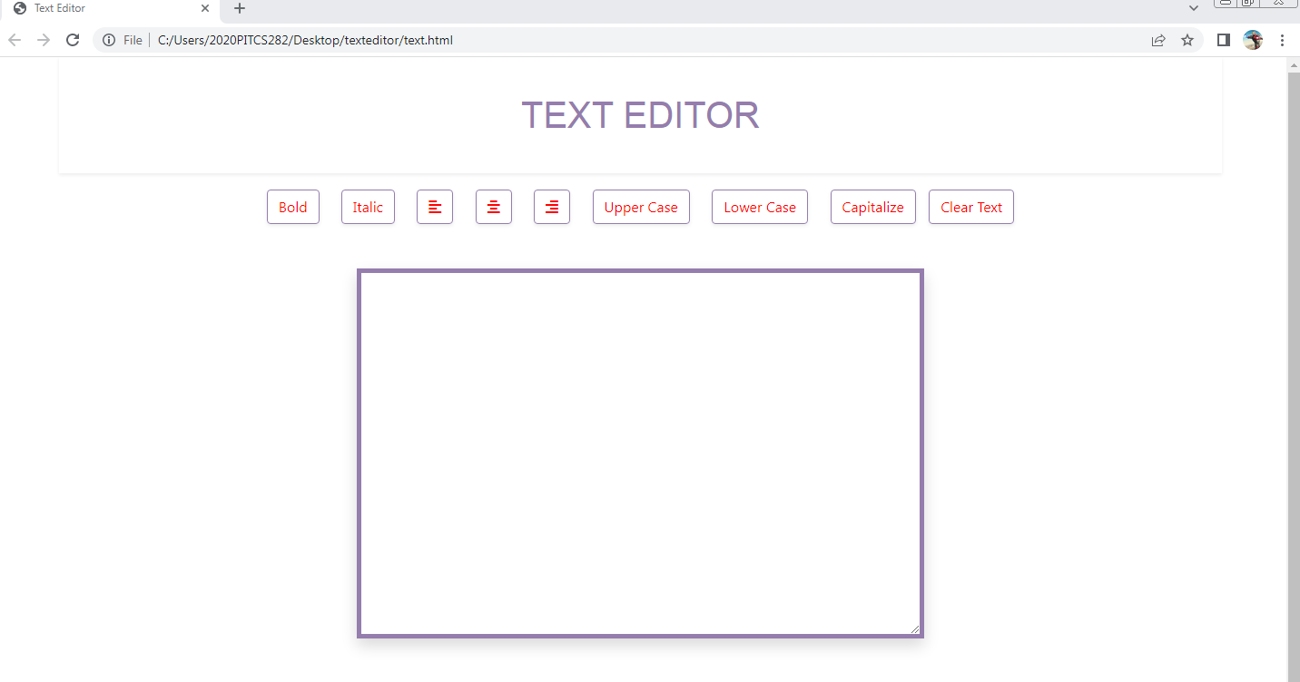
Past text editor output here

Slide 6
E-Commerce Github
https://github.com/VimalRaj-12/fullstack

